Slide 1
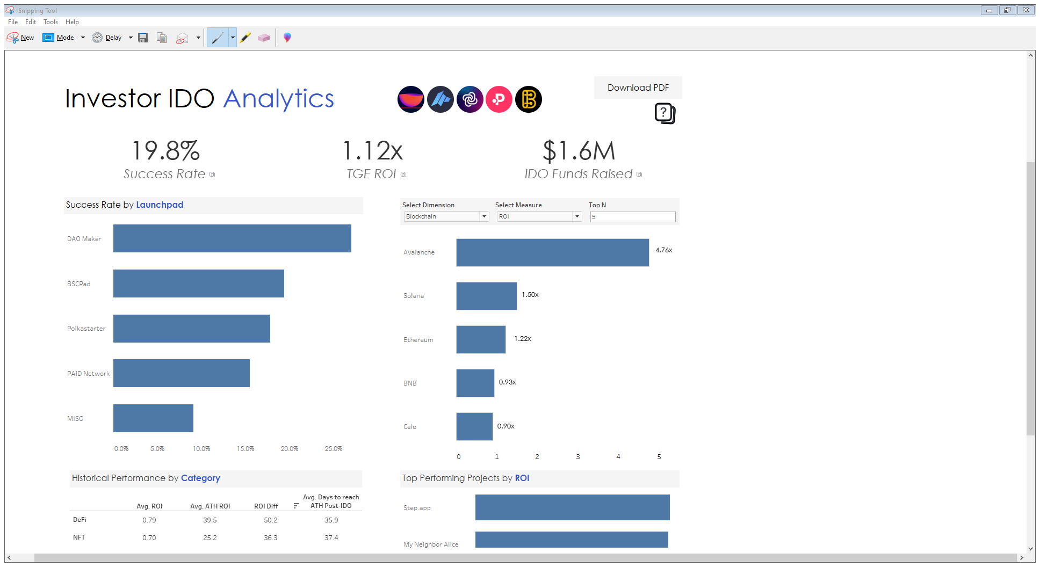

Slide 2
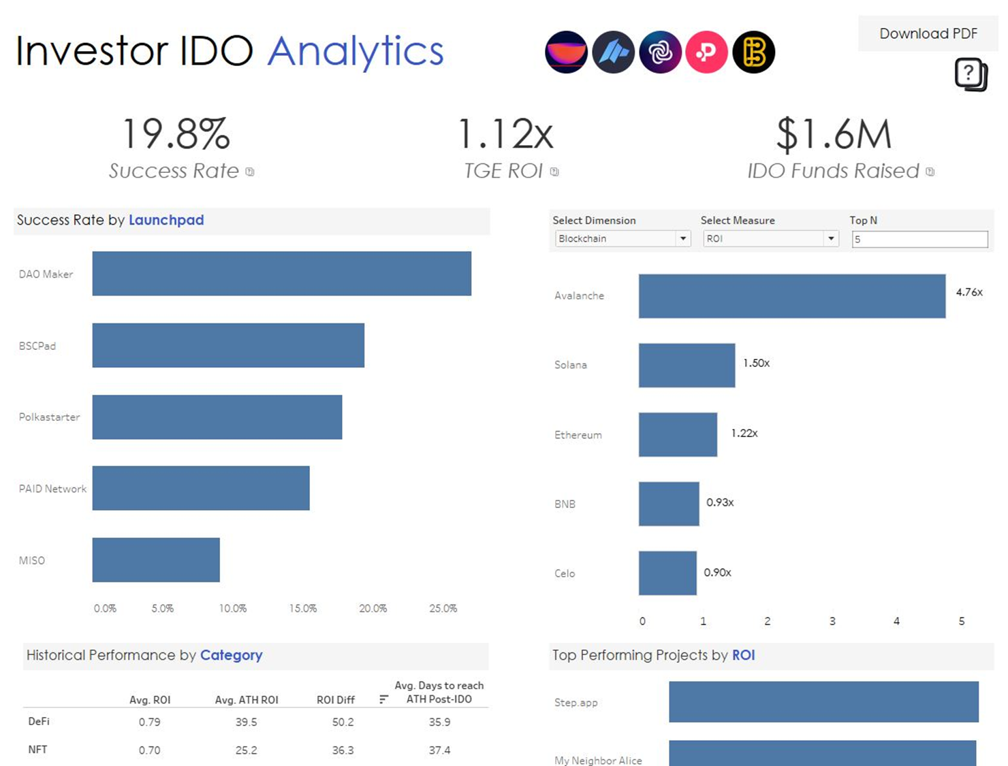
Filter the bar chart based on launchpad platforms, blockchains, or project categories.
Filter based on measures including the current ROI, IDO funding raised, current market cap, and trading volume (24 hours).
Set a cap based on the top # of results.
Every chart can be interacted with to drilldown on details.

Slide 3
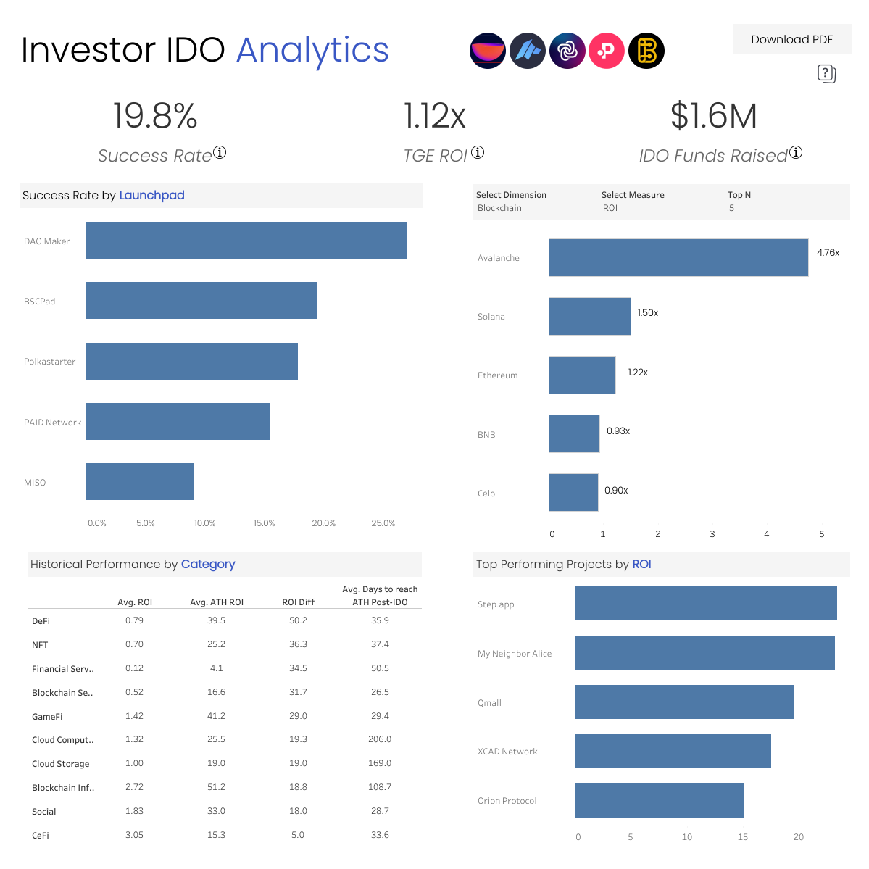
Filter based on measures including the current ROI, IDO funding raised, current market cap, and trading volume (24 hours).
Filter the bar chart based on launchpad platforms, blockchains, or project categories.
Set a cap based on the top # of results.
Every chart can be interacted with to drilldown on details.

